Slide 1
User Authentication

Slide 2
Assume an open distributed environment in which users at workstations wish to access services on servers distributed throughout the network.

Slide 3
User Authentication
fundamental security building block
  basis of access control & user accountability
is the process of verifying an identity claimed by or for a system entity
has two steps:
  identification - specify identifier
  verification - bind entity (person) and identifier
distinct from message authentication
Notes:
This chapter examines some of the authentication functions that have been developed to support network-based use authentication. In most computer security contexts, user authentication is the fundamental building block and the primary line of defense. User authentication is the basis for most types of access control and for user accountability. RFC 2828 defines user authentication as the process of verifying an identity claimed by or for a system entity. An authentication process consists of two steps:
Identification step: Presenting an identifier to the security system. (Identifiers should be assigned carefully, because authenticated identities are the basis for other security services, such as access control service.)
Verification step: Presenting or generating authentication information that corroborates the binding between the entity and the identifier.”
In essence, identification is the means by which a user provides a claimed identity to the system; user authentication is the means of establishing the validity of the claim. Note that user authentication is distinct from message authentication.

Slide 4
Means of User Authentication
four means of authenticating user's identity
based one something the individual
  knows - e.g. password, PIN
  possesses - e.g. key, token, smartcard
  is (static biometrics) - e.g. fingerprint, retina
  does (dynamic biometrics) - e.g. voice, sign
can use alone or combined
all can provide user authentication
all have issues
Notes:
There are four general means of authenticating a user's identity, which can be used alone or in combination:
• Something the individual knows: Examples includes a password, a personal identification number (PIN), or answers to a prearranged set of questions.
• Something the individual possesses: Examples include electronic keycards, smart cards, and physical keys. This type of authenticator is referred to as a token.
• Something the individual is (static biometrics): Examples include recognition by fingerprint, retina, and face.
• Something the individual does (dynamic biometrics): Examples include recognition by voice pattern, handwriting characteristics, and typing rhythm.
All of these methods, properly implemented and used, can provide secure user authentication. However, each method has problems. An adversary may be able to guess or steal a password. Similarly, an adversary may be able to forge or steal a token. A user may forget a password or lose a token. Further, there is a significant administrative overhead for managing password and token information on systems and securing such information on systems. With respect to biometric authenticators, there are a variety of problems, including dealing with false positives and false negatives, user acceptance, cost, and convenience.

Slide 5
Authentication Protocols
used to convince parties of each others identity and to exchange session keys
may be one-way or mutual
ONE WAY
required when sender & receiver are not in communications at same time (eg. email)
have header in clear so can be delivered by email system
may want contents of body protected & sender authenticated
MUTUAL
enable communicating parties to satisfy themselves mutually about each other's identity and to exchange session keys
Notes:
An important application area is that of mutual authentication protocols. Such protocols enable communicating parties to satisfy themselves mutually about each other's identity and to exchange session keys. The focus was on key distribution. We return to this topic here to consider the wider implications of authentication. Central to the problem of authenticated key exchange are two issues: confidentiality and timeliness. To prevent masquerade and to prevent compromise of session keys, essential identification and session key information must be communicated in encrypted form. This requires the prior existence of secret or public keys that can be used for this purpose. The second issue, timeliness, is important because of the threat of message replays.

Slide 6
Threats
A user may gain access to a particular workstation and pretend to be another user operating from that workstation.
Reply Attack: where a valid signed message is copied and later resent
countermeasures include
  use of sequence numbers (generally impractical)
  timestamps (needs synchronized clocks)
  challenge/response (using unique nonce)
Important Considerations
  confidentiality – to protect session keys
  timeliness – to prevent replay attacks
Notes:
Replay Attacks are where a valid signed message is copied and later resent. Such replays, at worst, could allow an opponent to compromise a session key or successfully impersonate another party. At minimum, a successful replay can disrupt operations by presenting parties with messages that appear genuine but are not. [GONG93] lists the examples above of replay attacks.
Possible countermeasures include the use of:
• sequence numbers (generally impractical since must remember last number used with every communicating party)
• timestamps (needs synchronized clocks amongst all parties involved, which can be problematic)
• challenge/response (using unique, random, unpredictable nonce, but not suitable for connectionless applications because of handshake overhead)

Slide 7
Key Distribution
At many points so far, we have run into problems with using cryptography for
network security.
  How can we securely store and distribute key
  and password information?
  How can we certify that keys and password are
  safe and to be trusted?
To solve these issues, we make use of a variety of trusted intermediaries.

Slide 8
Trusted Intermediaries
Symmetric key problem:
How do two entities establish shared secret key over network?
Solution:
trusted key distribution center (KDC) acting as intermediary between entities
Public key problem:
When Alice obtains Bob’s public key (from web site, e-mail, diskette), how does she know it is Bob’s public key, not Trudy’s?
Solution:
trusted certification authority (CA)

Slide 9
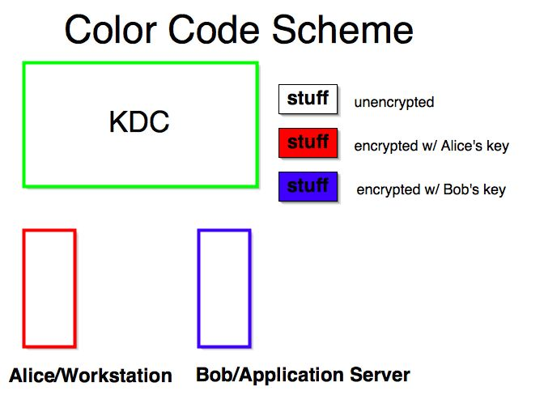

Slide 10
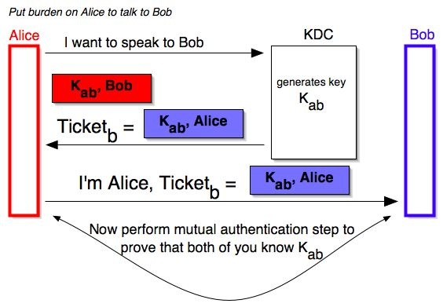
Mediated Authentication

Slide 11
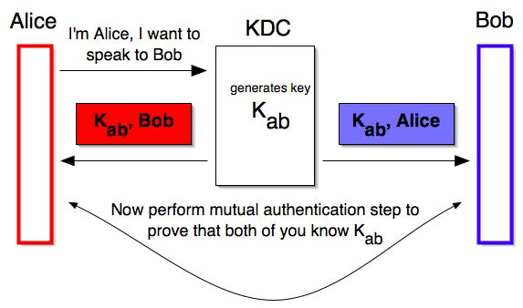
Mediated Authentication

Slide 12
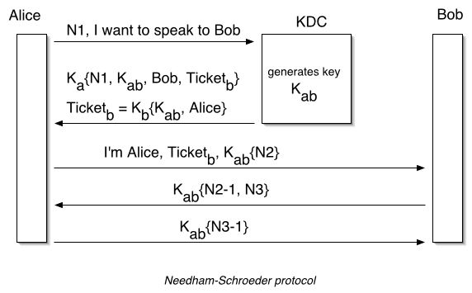
Needham-Schroeder Protocol

Slide 13
Needham-Schroeder Protocol
original third-party key distribution protocol
for session between A B mediated by KDC
protocol overview is:
  1. A->KDC: ID_{A} || ID_{B} || N₁
  2. KDC -> A: E(K_{a},[K_{s}||ID_{B}||N₁|| E(K_{b},[K_{s}||ID_{A}])])
  3. A -> B: E(K_{b}, [K_{s}||ID_{A}])
  4. B -> A: E(K_{s}, [N₂])
  5. A -> B: E(K_{s}, [f(N₂)])
Notes:
The Needham-Schroeder Protocol is the original, basic key exchange protocol. Used by 2 parties who both trusted a common key server, it gives one party the info needed to establish a session key with the other. Note that since the key server chooses the session key, it is capable of reading/forging any messages between A&B, which is why they need to trust it absolutely!
Note that all communications is between A&KDC and A&B, B&KDC don't talk directly (though indirectly a message passes from KDC via A to B, encrypted in B's key so that A is unable to read or alter it). Other variations of key distribution protocols can involve direct communications between B&KDC.

Slide 14
Needham-Schroeder Protocol
used to securely distribute a new session key for communications between A & B
but is vulnerable to a replay attack if an old session key has been compromised
  then message 3 can be resent convincing B that is communicating with A
modifications to address this require:
  timestamps in steps 2 & 3 (Denning 81)
  using an extra nonce (Neuman 93)
Notes:
There is a critical flaw in the protocol, as shown. The message in step 3 can be decrypted, and hence understood, supposedly only by B. But if an opponent, X, has been able to compromise an old session key, then X can impersonate A and trick B into using the old key by simply replaying step 3. Admittedly, this is a much more unlikely occurrence than that an opponent has simply observed and recorded step 3. It can however be corrected by either using timestamps, or an additional nonce, with respective advantages and limitations, see text for discussion.
This example emphasises the need to be extremely careful in codifying assumptions, and tracking the timeliness of the flow of info in protocols. Designing secure protocols is not easy, and should not be done lightly. Great care and analysis is needed.

Slide 15
One-Way Authentication
use refinement of KDC to secure email
  since B no online, drop steps 4 & 5
protocol becomes:
  1. A->KDC: ID_{A} || ID_{B} || N₁
  2. KDC -> A: E(K_{a}, [K_{s}||ID_{B}||N₁ || E(K_{b},[K_{s}||ID_{A}])])
  3. A -> B: E(K_{b}, [K_{s}||ID_{A}]) || E(K_{s}, M)
provides encryption & some authentication
does not protect from replay attack
Notes:
Because we wish to avoid requiring that the recipient (B) be on line at the same time as the sender (A), steps 4 and 5 must be eliminated. For a message with content M, the sequence is as shown. This approach guarantees that only the intended recipient of a message will be able to read it. It also provides a level of authentication that the sender is A. As specified, the protocol does not protect against replays. Some measure of defense could be provided by including a timestamp with the message. However, because of the potential delays in the e-mail process, such timestamps may have limited usefulness.

Slide 16
KERBEROS

Slide 17
Introduction to Kerberos
Kerberos provides a way to authenticate clients to services to each other through a trusted third party (KDC).
Kerberos makes the assumption that the connection between a client and service is insecure.
Passwords are encrypted to prevent others from reading them.
Clients only have to authenticate once during a pre-defined lifetime.

Slide 18
RFC 1510
  Kerberos provides a means of verifying the identities of principals, (e.g., a workstation user or a network server) on an open (unprotected) network. This is accomplished without relying on authentication by the host operating system, without basing trust on host addresses, without requiring physical security of all the hosts on the network, and under the assumption that packets traveling along the network can be read, modified, and inserted at will. Kerberos performs authentication under these conditions as a trusted third-party authentication service by using conventional cryptography, i.e., shared secret key.

Slide 19
History
Kerberos was designed and developed at MIT by Project Athena.
Currently, Kerberos is up to Version 5.
Version 4 being the first version to be released outside of MIT.
Kerberos has been adopted by several private companies as well as added to several operating systems.

Slide 20
Kerberos v4 Overview
a basic third-party authentication scheme
have an Authentication Server (AS)
  users initially negotiate with AS to identify self
  AS provides a non-corruptible authentication credential (ticket granting ticket TGT)
have a Ticket Granting server (TGS)
  users subsequently request access to other services from TGS on basis of users TGT
using a complex protocol using DES
Notes:
The core of Kerberos is the Authentication and Ticket Granting Servers – these are trusted by all users and servers and must be securely administered. The protocol includes a sequence of interactions between the client, AS, TGT and desired server. Version 4 of Kerberos makes use of DES, in a rather elaborate protocol, to provide the authentication service. Viewing the protocol as a whole, it can be difficult to see the need for the many elements contained therein. The text contains more detailed discussion about the development of and need for the components of the final v4 protocol.

Slide 21
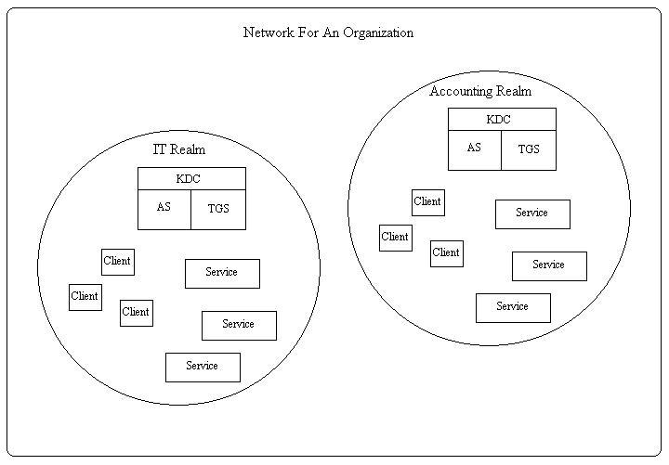
Components

Slide 22
Kerberos Terms
Authentication Service (AS): This service runs on the Key Distribution Center (KDC) server. It authenticates a client logon and issues a Ticket Granting Ticket (TGT) for future authentication.
Ticket Granting Service (TGS): This service runs on the KDC server. It grants tickets to TGT holding clients for a specific application server or resource.
Ticket Granting Ticket (TGT): This ticket is received from the Authentication Service (SA) that contains the client’s Privilege Attribute Certificate (PAC).
Ticket: This ticket is received from the TGS that provides authentication for a specific application server or resource.
Session Key: This is the derived value used strictly for the immediate session between a client and a resource.
Privilege Attribute Certificate (PAC): This is strictly used in Windows 2000 Kerberos authentication. Contains information such as the user’s Security ID (SID), group membership SIDs, and users’ rights on the domain.

Slide 23
How does Kerberos work?
Instead of client sending password to application server:
  Request Ticket from authentication server
  Ticket and encrypted request sent to application server
How to request tickets without repeatedly sending credentials?
  Ticket granting ticket (TGT)

Slide 24
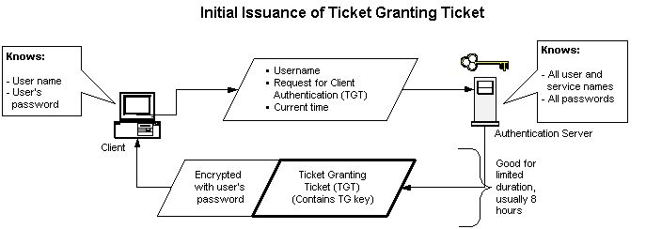
How does Kerberos work?: Ticket Granting Tickets

Slide 25
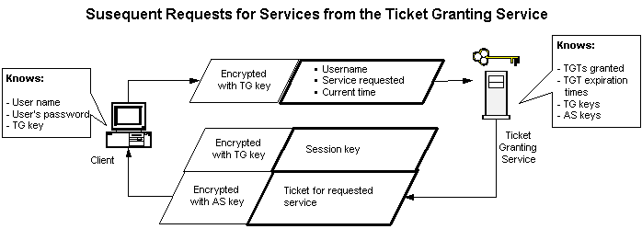
How does Kerberos Work?: The Ticket Granting Service

Slide 26
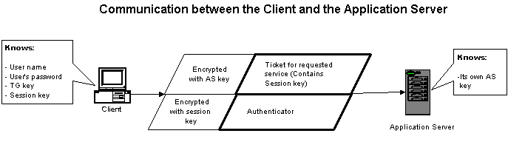
How does Kerberos work?: The Application Server

Slide 27
KERBEROS IN DETAIL

Slide 28
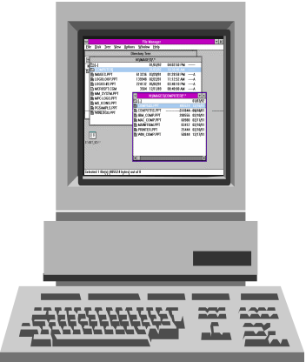
Domain Authentication and Resource Access
1. Request a ticket for TGS
Authentication
Service (AS)
2. Return TGT to client
3. Send TGT and request for ticket to \\AppServ
Ticket
Granting
Service (TGS)
4. Return ticket for \\AppServ
Kerberos
client
5. Send session ticket to \\AppServ
6. (Optional) Send confirmation of identity to client
Windows 2000
domain controller
(KDC)
\\AppServ

Slide 29
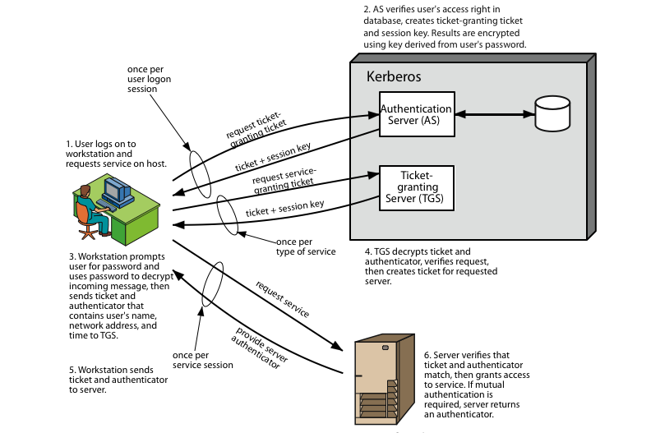
Kerberos 4 Overview
Network Security - G. Steffen

Slide 30
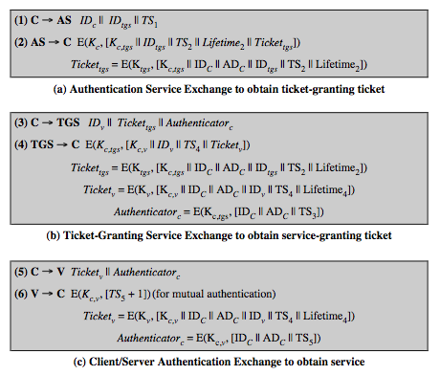
Kerberos v4 Dialogue
Notes:
First, consider the problem of captured ticket-granting tickets and the need to determine that the ticket presenter is the same as the client for whom the ticket was issued. An efficient way of doing this is to use a session encryption key to secure information. This shows the technique for distributing the session key. Note that several additional pieces of information have been added to this first phase of the dialogue. Message (1) includes a timestamp, so that the AS knows that the message is timely. Message (2) includes several elements of the ticket in a form accessible to C. This enables C to confirm that this ticket is for the TGS and to learn its expiration time. Note that the ticket does not prove anyone's identity but is a way to distribute keys securely. It is the authenticator that proves the client's identity. Because the authenticator can be used only once and has a short lifetime, the threat of an opponent stealing both the ticket and the authenticator for presentation later is countered. C then sends the TGS a message that includes the ticket plus the ID of the requested service (message 3). The reply from the TGS, in message (4), follows the form of message (2). C now has a reusable service-granting ticket for V. When C presents this ticket, as shown in message (5), it also sends an authenticator. The server can decrypt the ticket, recover the session key, and decrypt the authenticator. If mutual authentication is required, the server can reply as shown in message (6)

Slide 32
AS_REQ
E_{U(LTSK)}(Authenticator), Username
Authentication
Service (AS)
AS_REP
E_{KDC}(TGT), E_{U}(SK)
Ticket
Granting
Service (TGS)
TGS_REQ
E_{KDC}(TGT), E_{SK}(Authenticator), AppSrv
TGS_REP
Windows 2000
domain controller
(KDC)
E_{AppSrv}(Ticket), E_{SK(C-K)}(SK_{C-A})
Client Logon
Legend
LTSK: Long Term Symmetric Key
SK: Session Key
E: Encrypted
C: Client
K: KDC
A: AppSrv
Username
Password
Long Term Symmetric Key (LTSK)
Cache
AP_REQ
E_{AppSrv}(Ticket), E_{SKC}(Authenticator)
AP_REP
E_{SKC-A}(time stamp)
\\AppServ

Slide 33
The Kerberos Protocol
Suppose a client C wants to communicate with a server S in a Kerberos version 5 realm.
Step 1:
The first step is for the client to authenticate itself with the Kerberos Authentication Service and request a Ticket Granting Ticket.
This requests a ticket for client (C) for the Ticket Granting Service (TGS), with N₁ as a timestamp nonce.
C
AS
C, K_{C-AS}(TGS, N₁)

Slide 34
The Kerberos Protocol
Step 2:
When the Authentication Service receives the request, it decrypts the request and verifies the client’s identity. It then generates a session key for the client and Ticket Granting Service to use, as well as a ticket. It sends back:
where
TGT = (C, TGS, T₁, L₁, K_{C-TGS})
T₁, L₁ are the ticket’s timestamp and lifespan
Since this is encrypted with C’s secret key, only the client can make use of it, and only the Authentication Service could have sent it.
C
AS
K_{C-AS}(K_{C-TGS}, K_{AS-TGS}(TGT),N₁)

Slide 35
The Kerberos Protocol
Step 3:
With the client authenticated, it decrypts the response to get a session key for the Ticket Granting Service and a ticket-granting ticket.
When the client needs to contact the server S, it creates a fresh authenticator (AUTH) and requests a ticket from the Ticket Granting Service:
where
AUTH=(C, ADc, N₃)
C
TGS
K_{C-TGS}(AUTH), K_{AS-TGS}(TGT), S, N₂

Slide 36
The Kerberos Protocol
Step 4:
The Ticket Granting Service decrypts the ticket-granting ticket and obtains the session key within it.
The service decrypts the authenticator and compares client identifiers in the authenticator and ticket.
The service generates a new session key for the client and server, as well as a service ticket, and sends:
where
STK = (C, S, T₂, L₂, K_{C-S})
T₂, L₂ are the ticket’s timestamp and lifespan
Since this is encrypted with the session key, only the client can make use of it, and only the Ticket Granting Service could have sent it.
C
TGS
K_{C-TGS}(K_{C-S}, K_{S-AS}(STK),N₂)

Slide 37
The Kerberos Protocol
Step 5:
The client decrypts the response from the Ticket Granting Service to get the session key for the server and a service ticket to use with it.
When the client needs to contact the server S, it creates a fresh authenticator (AUTH) and sends this, along with the service ticket, and its request R:
where
AUTH=(C, N₅)
C
S
K_{C-S}(AUTH), K_{S-AS}(STK), R, N₄

Slide 38
The Kerberos Protocol
Step 6:
The server decrypts the service ticket and obtains the session key within it.
The server decrypts the authenticator and compares client identifiers in the authenticator and ticket.
The server executes request R and replies with answer A, and the nonce in the client’s request.
Since this is encrypted with the session key, only the client can make use of it, and only server could have sent it. The session key can be used for additional requests in this session, and then destroyed.
C
S
K_{C-S}(A, N₄)

Slide 39
The Kerberos Protocol
C
AS
TGS
S
C, K_{C-AS}(TGS, N₁)
K_{C-AS}(K_{C-TGS}, K_{AS-TGS}(TGT),N₁)
K_{C-TGS}(AUTH), K_{AS-TGS}(TGT), S, N₂
K_{C-TGS}(K_{C-S}, K_{S-AS}(STK),N₂)
K_{C-S}(AUTH), K_{S-AS}(STK), R, N₄
K_{C-S}(A, N₄)

Slide 40
Kerberos Policy Win 2000 Server
Kerberos Policy Settings
On a domain controller in your domain in Administrative Tools, click Domain Security Policy, click Windows Settings, click Security Settings, click Account Policies, and then click Kerberos Policy.
  Enforce logon restrictions: Yes
  Maximum lifetime that a user ticket can be renewed: 7 days
  Maximum service ticket lifetime: 60 minutes
  Maximum tolerance for synchronization of computer clocks: 5 minutes
  Maximum TGT lifetime: 10 hours

Slide 41
Strengths
  Passwords are never sent across the network unencrypted. This prevents those unscrupulous people from being able to read the most important data sent over the network.
  Clients and applications services mutually authenticate. Mutual authentication allows for both ends to know that they truly know whom they are communicating with.
  Tickets have a limited lifetime, so if they are stolen, unauthorized use is limited to the time frame that the ticket is valid.

Slide 42
Weaknesses
Kerberos only provides authentication for clients and services.
Kerberos 4 uses DES, which has been shown to be vulnerable to brute-force-attacks with little computing power.
The principal-key database on the KDC has to be hardened or else bad things can happen.
Like any security tool, it is also vulnerable to users making poor password choices.

Slide 43
Conclusions
Organizations have networks based on the client-server model, but clients and servers never meet.
How do we prove identities then?
Must have some way of authentication to enable security.
However, an increase in security increases user burden.

Slide 44
Conclusions
Kerberos provides a means of authentication coupled with convenience over an unprotected network.
Kerberos never allows passwords to be sent unencrypted.
Initially developed at MIT, Kerberos is available from many sources and has a wide support base and documentation.

Slide 46
What is Kerberos?
Developed by MIT
Shared secret-based strong 3rd party authentication
Provides single sign-on capability
Passwords never sent across network
And now – the players…

Slide 47
XYZ Service
Key
Distribution
Center
Ticket
Granting
Service
Think “Kerberos Server” and don’t let yourself get mired in terminology.
Authen-
Tication
Service
Susan’s
Desktop
Computer
Susan

Slide 48
XYZ Service
Key
Distribution
Center
Ticket
Granting
Service
Represents something requiring Kerberos authentication (web server, ftp server, ssh server, etc…)
Authen-
Tication
Service
Susan’s
Desktop
Computer
Susan

Slide 49
XYZ Service
Key
Distribution
Center
Ticket
Granting
Service
“I’d like to be allowed to get tickets from the Ticket Granting Server, please.
Authen-
Tication
Service
Susan’s
Desktop
Computer
Susan

Slide 50

XYZ Service
Key
Distribution
Center
Ticket
Granting
Service
“Okay. I locked this box with your secret password. If you can unlock it, you can use its contents to access my Ticket Granting Service.”
Authen-
Tication
Service
Susan’s
Desktop
Computer
Susan

Slide 51

XYZ Service
Key
Distribution
Center
Ticket
Granting
Service
Authen-
Tication
Service
Susan’s
Desktop
Computer
TGT
myPassword
Susan

Slide 52
Because Susan was able to open the box (decrypt a message) from the Authentication Service, she is now the owner of a shiny “Ticket-Granting Ticket”.
The Ticket-Granting Ticket (TGT) must be presented to the Ticket Granting Service in order to acquire “service tickets” for use with services requiring Kerberos authentication.
The TGT contains no password information.
TGT

Slide 53
XYZ Service
“Let me prove I am Susan to XYZ Service.
Here’s a copy of my TGT!”
Key
Distribution
Center
Ticket
Granting
Service
Authen-
Tication
Service
TGT
TGT
Susan’s
Desktop
Computer
use XYZ
Susan

Slide 54
XYZ Service
Hey XYZ:
Susan is Susan.
CONFIRMED: TGS
Key
Distribution
Center
Ticket
Granting
Service
You’re Susan.
Here, take this.
Authen-
Tication
Service
TGT
Susan’s
Desktop
Computer
Susan

Slide 55
XYZ Service
Key
Distribution
Center
Ticket
Granting
Service
I’m Susan. I’ll prove it. Here’s a copy of my legit service ticket for XYZ.
Authen-
Tication
Service
Hey XYZ:
Susan is Susan.
CONFIRMED: TGS
Hey XYZ:
Susan is Susan.
CONFIRMED: TGS
TGT
Susan’s
Desktop
Computer
Susan

Slide 56
XYZ Service
That’s Susan alright. Let me determine if she is authorized to use me.
Key
Distribution
Center
Ticket
Granting
Service
Hey XYZ:
Susan is Susan.
CONFIRMED: TGS
Authen-
Tication
Service
Hey XYZ:
Susan is Susan.
CONFIRMED: TGS
TGT
Susan’s
Desktop
Computer
Susan

Slide 57
Authorization checks are performed by the XYZ service…
Just because Susan has authenticated herself does not inherently mean she is authorized to make use of the XYZ service.

Slide 58
One remaining note:
Tickets (your TGT as well as service-specific tickets) have expiration dates configured by your local system administrator(s). An expired ticket is unusable.
Until a ticket’s expiration, it may be used repeatedly.

Slide 59
XYZ Service
Key
Distribution
Center
Ticket
Granting
Service
ME AGAIN! I’ll prove it. Here’s another copy of my legit service ticket for XYZ.
Authen-
Tication
Service
Hey XYZ:
Susan is Susan.
CONFIRMED: TGS
Hey XYZ:
Susan is Susan.
CONFIRMED: TGS
TGT
Susan’s
Desktop
Computer
use XYZ
Susan

Slide 60
XYZ Service
That’s Susan… again. Let me determine if she is authorized to use me.
Key
Distribution
Center
Ticket
Granting
Service
Hey XYZ:
Susan is Susan.
CONFIRMED: TGS
Authen-
Tication
Service
Hey XYZ:
Susan is Susan.
CONFIRMED: TGS
TGT
Susan’s
Desktop
Computer
Susan

